Slide 1
Lecture 1: Optimization problems and challenges in Lagrangian turbulence
Optimal policies for Lagrangian turbulence – Dr. Robin Heinonen
Aqtivate workshop on data-driven and model-based tools for complex flows and complex fluids
June 3-7

Slide 2
Short course outline
Introduce basics of Lagrangian turbulence phenomenology
Introduce two optimization problems in Lagrangian turbulence: active microswimmers and olfactory search
Formulate problems as Markov Decision Processes
Discuss solution of problems using various approaches: optimal control theory, dynamic programming, reinforcement learning
Hands-on: build heuristic policies for olfactory search
Notes:
We have 5 lectures of material rather than 6. Should have plenty of time. Interrupt me with questions if anything is unclear! Ask for students’ emails to send lecture slides and eventually give permissions for hands-on. Emphasize that we will be discussing RESEARCH-LEVEL problems in a very active field. We are limited in what we can realistically do in hands-on session

Slide 3
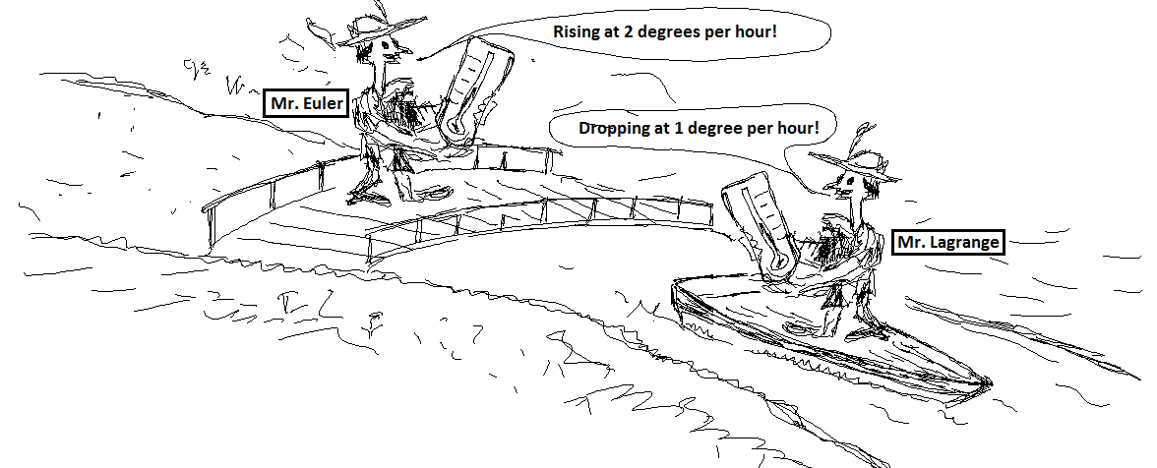



What is Lagrangian turbulence?
Lagrangian description
Study properties of infinitesimal parcels of fluids as they are advected by the flow
Parcel position $X$ is solution to equation of motion
$$∂_{t}X\left(t;x_{0}\right)=u_{L}(t;x_{0})$$
with $u_{L}\left(t;x_{0}\right)=u_{E}(X\left(t;x_{0}\right),t)$
“Co-moving frame” description
Eulerian description
Study fields specified as functions of positions and time, e.g. $u_{E}\left(x,t\right), c(x,t)$
Fields are solutions of PDEs:
$$∂_{t}u_{E}+{\left(u_{E}⋅∇\right)u}_{E}=−∇p+ν∇^{2}u_{E}+f(x,t)$$
$$∇⋅u_{E}=0$$
$$∂_{t}c+∇⋅\left(cu_{E}\right)=κ∇^{2}c+S(x,t)$$
“Laboratory frame” description
Lagrangian turbulence: the study of turbulent flows in the Lagrangian description
Euler is measuring $∂_{t}T$ and Lagrange is measuring
$\frac{DT}{Dt}=∂_{t}T+\left(u⋅∇\right)T$

Slide 4
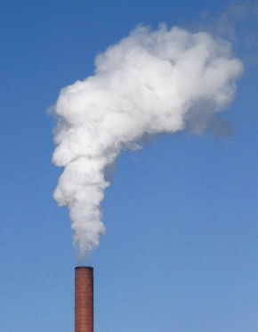
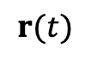

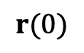


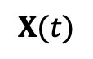

Typical problems in Lagrangian turbulence
$$X(t)$$
Trajectories and statistics of single tracer particles
Dispersion of two or more tracer particles
Passive scalar advection and plumes
Control and navigation of microswimmers
$$t=0$$
$$\left\langle |X{\left(t\right)|}^{2p}\right\rangle = ?(p=1,2,…)$$
$$r(0)$$
$$r(t)$$
$$t=0$$
$$\left\langle |r{\left(t\right)|}^{2p}\right\rangle = ?$$
Notes:
GO TO BLACKBOARD AFTERWARDS, WORK OUT TAYLOR AND RICHARDSON

Slide 5

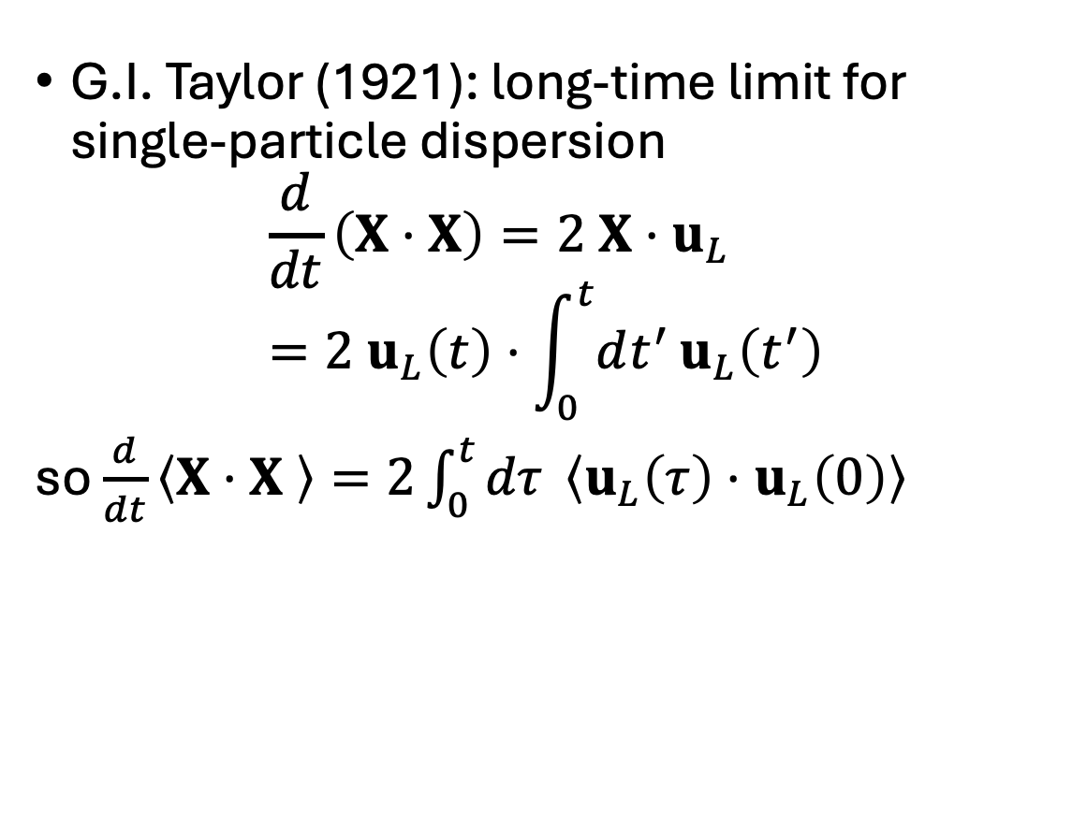
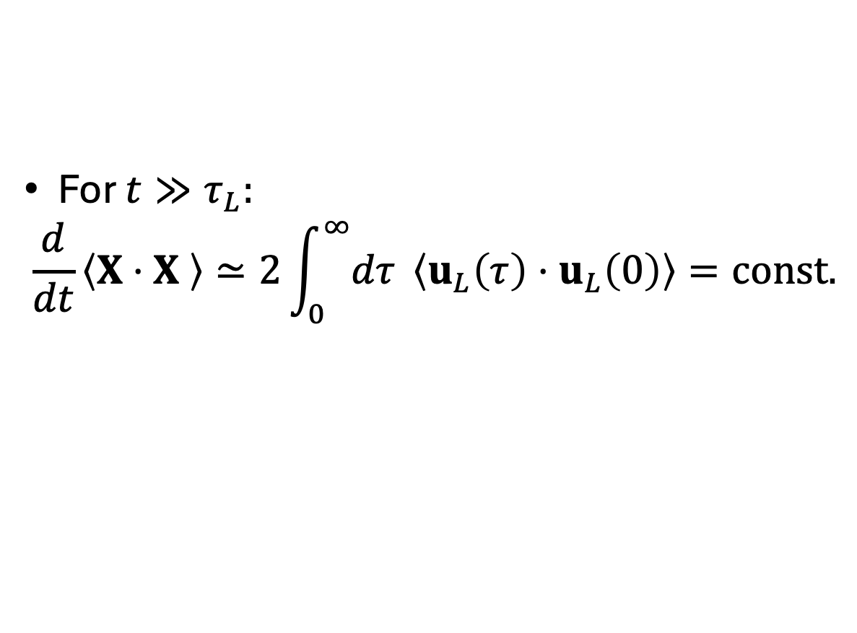

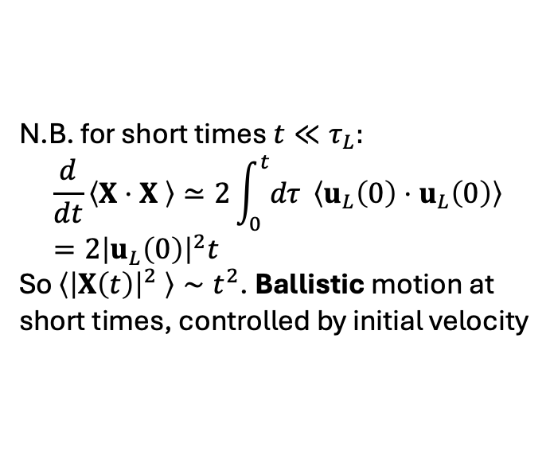
Single-particle dispersion
G.I. Taylor (1921): long-time limit for single-particle dispersion
$$\frac{d}{dt}\left(X⋅X\right)=2 X⋅u_{L}=2 u_{L}\left(t\right)⋅\int_{0}^{t}{dt^{′}}u_{L}\left(t^{′}\right)$$
so $\frac{d}{dt}\left\langle X⋅X \right\rangle =2\int_{0}^{t}{dτ }\left\langle u_{L}\left(τ\right)⋅u_{L}\left(0\right)\right\rangle$
$$X(t)$$
$$t=0$$
$$\left\langle |X{\left(t\right)|}^{2}\right\rangle = ?$$
N.B. for short times $t≪τ_{L}:$
$$\frac{d}{dt}\left\langle X⋅X \right\rangle ≃2\int_{0}^{t}{dτ }\left\langle u_{L}\left(0\right)⋅u_{L}\left(0\right)\right\rangle =2{\left|u_{L}\left(0\right)\right|}^{2}t$$
So $\left\langle {\left|X\left(t\right)\right|}^{2} \right\rangle ∼t^{2}$. Ballistic motion at short times, controlled by initial velocity
For $t≫τ_{L}:$
$$\frac{d}{dt}\left\langle X⋅X \right\rangle ≃2\int_{0}^{∞}{dτ }\left\langle u_{L}\left(τ\right)⋅u_{L}\left(0\right)\right\rangle =const.$$
Two-time, longitudinal Lagrangian velocity correlation function
So $\left\langle {\left|X\left(t\right)\right|}^{2} \right\rangle ∼t.$ Effective diffusion at long times!

Slide 6
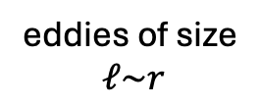
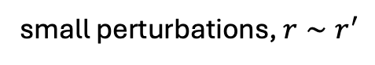
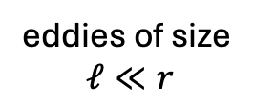

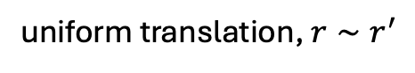

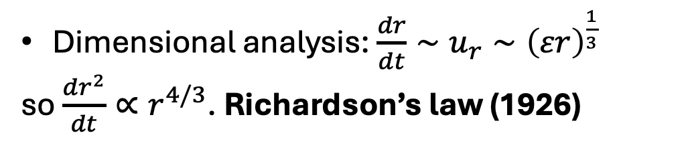

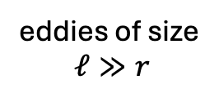




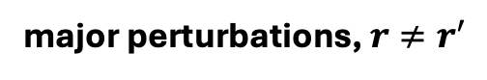

Two-particle dispersion
$$r$$
$$r^{′}$$
If particles separated by $r$, only eddies of size $ℓ∼r$ effective at displacing particles
Therefore expect $\frac{dr}{dt}=f\left(u_{r},t\right)$ where $u_{ℓ}$ is typical velocity at scale $ℓ$
Self-similar cascade: eddies pass on their energy in one turnover time $τ∼ℓ/u_{ℓ}$ i.e. dissipation rate is
eddies of size
$ℓ≪r$
small perturbations, $r∼r^{′}$
$$r$$
eddies of size
$ℓ\sim r$
$$r^{′}$$
$$ε∼\frac{u_{ℓ}^{2}}{ℓ/u_{ℓ}}=\frac{u_{ℓ}^{3}}{ℓ}, ⇒u_{ℓ}∼{\left(εℓ\right)}^{1/3}$$
major perturbations, $r≠r^{′}$
Dimensional analysis: $\frac{dr}{dt}∼u_{r}∼{\left(εr\right)}^{\frac{1}{3}}$
so $\frac{dr^{2}}{dt}∝r^{4/3}$. Richardson’s law (1926)
$$r$$
eddies of size
$ℓ≫r$
$$r^{′}$$
uniform translation, $r∼r^{′}$

Slide 7
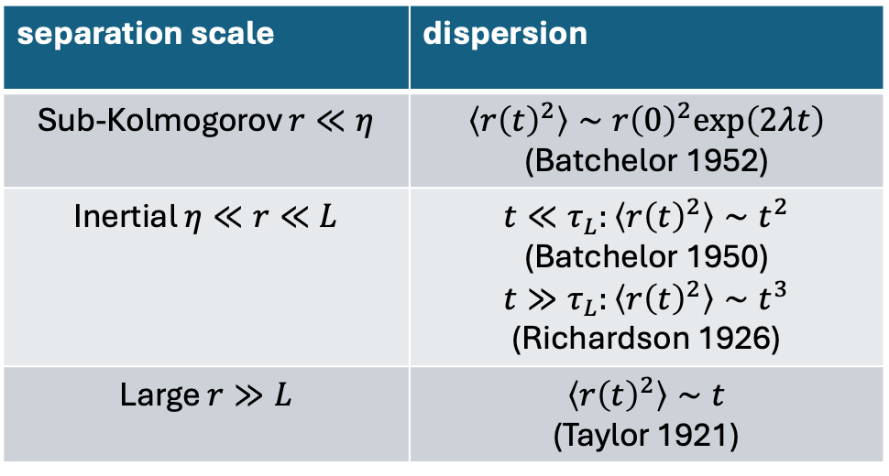
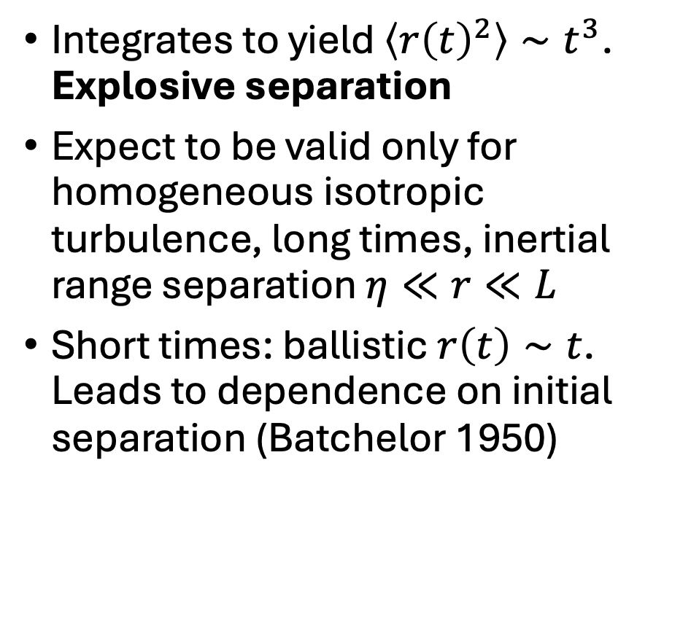
Two-particle dispersion, cont’d
Integrates to yield $\left\langle r{\left(t\right)}^{2}\right\rangle ∼t^{3}$. Explosive separation
Expect to be valid only for homogeneous isotropic turbulence, long times, inertial range separation $η≪r≪L$
Short times: ballistic $r\left(t\right)∼t$. Leads to dependence on initial separation (Batchelor 1950)
separation scale | dispersion
Sub-Kolmogorov $r≪η$ | $$\left\langle {r\left(t\right)}^{2}\right\rangle ∼r{\left(0\right)}^{2}exp\left(2λt\right)$$ (Batchelor 1952)
Inertial $η≪r≪L$ | $t≪τ_{L}:\left\langle r{\left(t\right)}^{2}\right\rangle ∼t^{2}$ (Batchelor 1950) $$t≫τ_{L}:\left\langle r{\left(t\right)}^{2}\right\rangle ∼t^{3}$$ (Richardson 1926)
Large $r≫L$ | $$\left\langle r{\left(t\right)}^{2}\right\rangle ∼t$$ (Taylor 1921)

Slide 8
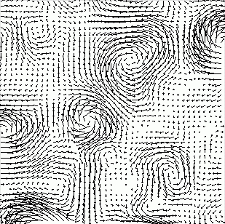
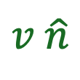
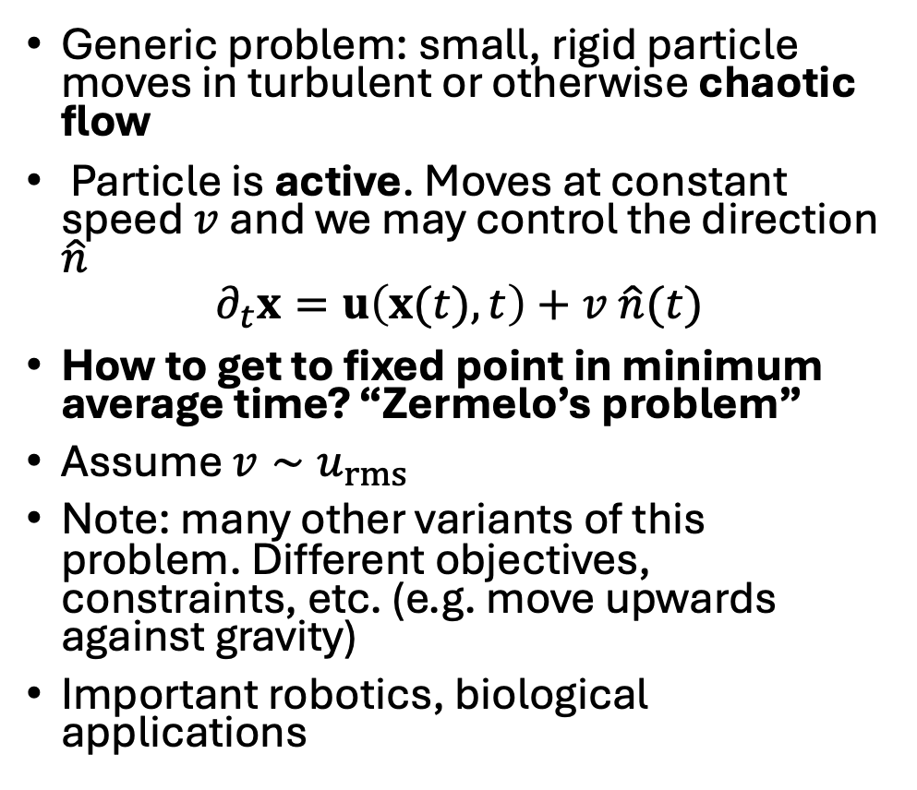
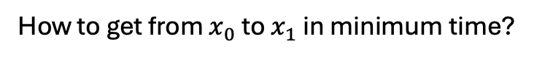
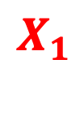
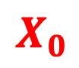
Active microswimmers
$$X_{0}$$
Generic problem: small, rigid particle moves in turbulent or otherwise chaotic flow
Particle is active. Moves at constant speed $v$and we may control the direction $\hat{n}$
$$∂_{t}x=u\left(x(t),t\right)+v \hat{n}(t)$$
How to get to fixed point in minimum average time? “Zermelo’s problem”
Assume $v∼u_{rms}$
Note: many other variants of this problem. Different objectives, constraints, etc. (e.g. move upwards against gravity)
Important robotics, biological applications
$v \hat{n}$
$$X_{1}$$
How to get from $x_{0}$ to $x_{1}$ in minimum time?

Slide 9
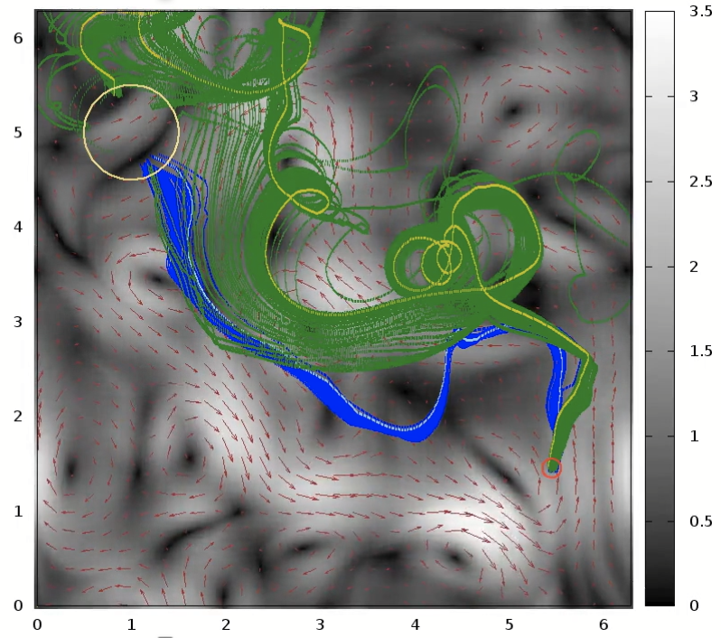
Swimming is hard
In green: particles navigating with naïve policy (swim towards goal). In blue: particles navigating with policy that has learned how to exploit the flow (we will discuss how to do this later)
Contribution from the flow to the motion is chaotic at high Re — and for many flows, also at low Re
Small perturbations in initial position have huge consequences. “Lagrangian chaos”
At high Re, particle trajectories conjectured to be random even when forcing vanishes. “Spontaneous stochasticity”
Intermittency: turbulence is strongly non-Gaussian. Large fluctuations in velocity!
Notes:
This is one of our main problems for this course. before we get to the other main problem, let’s discuss some more physics…

Slide 10
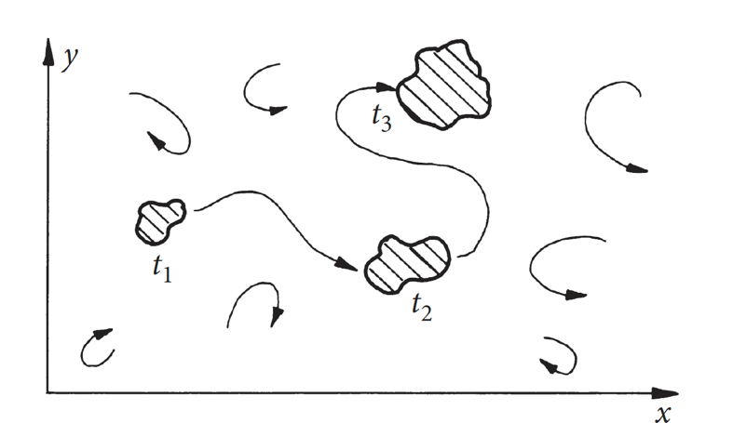
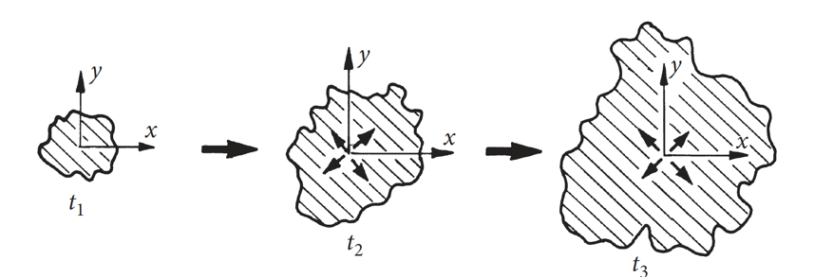
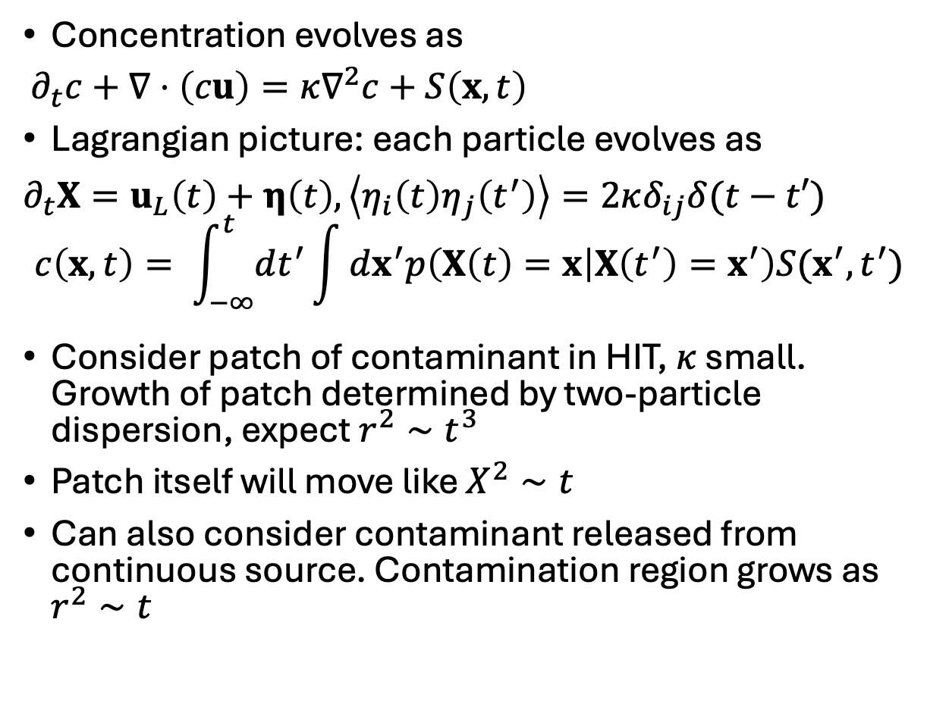
Passive scalars: time evolution
Pictures from Davidson’s Turbulence (2015)
Concentration evolves as
$∂_{t}c+∇⋅\left(cu\right)=κ∇^{2}c+S\left(x,t\right)$
Lagrangian picture: each particle evolves as
$∂_{t}X=u_{L}\left(t\right)+η\left(t\right), \left\langle η_{i}\left(t\right)η_{j}\left(t^{′}\right)\right\rangle =2κδ_{ij}δ(t−t′)$
$$c\left(x,t\right)= \int_{−∞}^{t}{dt^{′}}\int{dx^{′}p\left(X\left(t\right)=x | X\left(t^{′}\right)=x^{′}\right)S(x^{′},t^{′})}$$
Consider patch of contaminant in HIT, $κ$ small. Growth of patch determined by two-particle dispersion, expect $r^{2}∼t^{3}$
Patch itself will move like $X^{2}∼t$
Can also consider contaminant released from continuous source. Contamination region grows as $r^{2}∼t$
Patch of contaminant moves
and grows over time
Growth of contaminant region from
continuous point source
Notes:
Lagrangian picture of concentration: count contributions from all possible trajectories particles could have taken to get to x at time t. p(X(t)=x|X(t’)=x’) can be expressed as a path integral

Slide 11
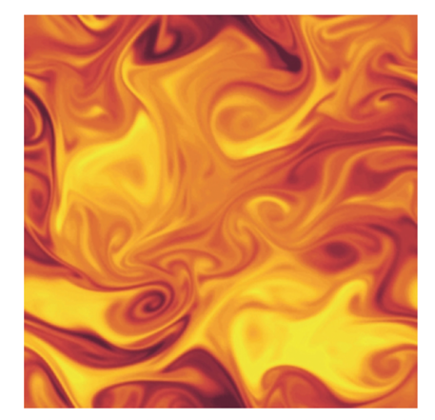
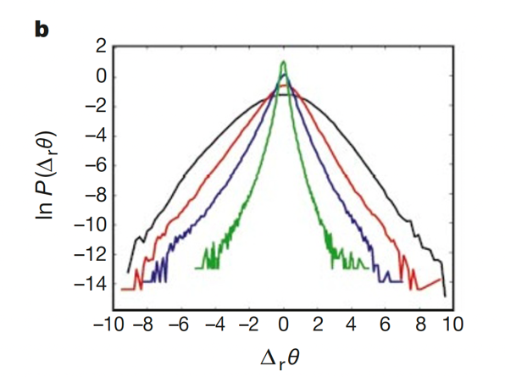
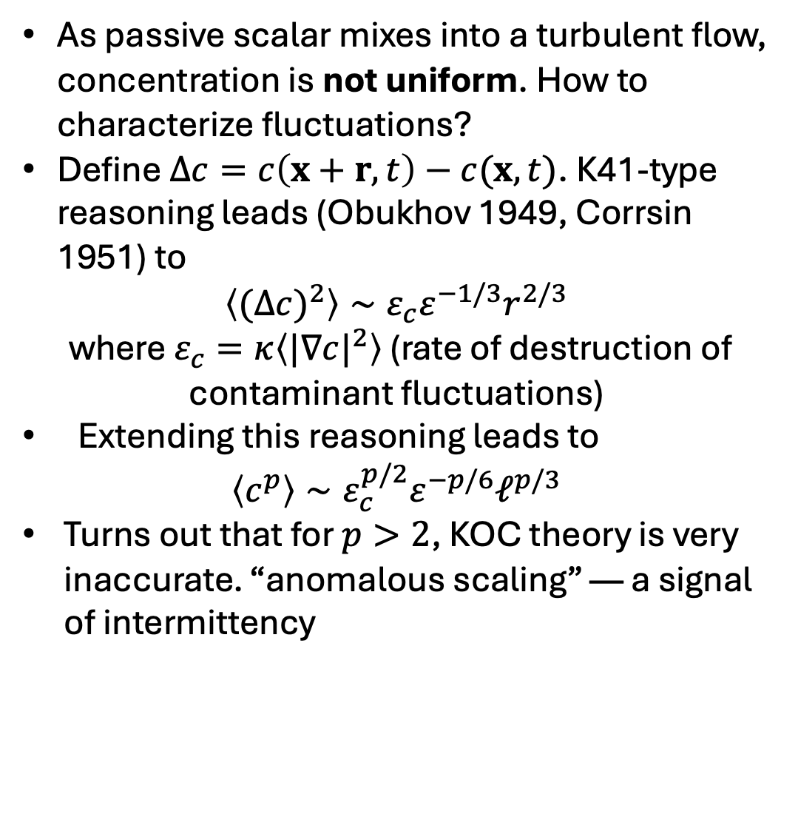
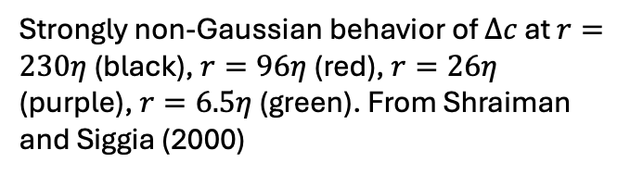
Passive scalars: fluctuations
As passive scalar mixes into a turbulent flow, concentration is not uniform. How to characterize fluctuations?
Define $Δc=c\left(x+r,t\right)−c(x,t)$. K41-type reasoning leads (Obukhov 1949, Corrsin 1951) to
$\left\langle {(Δc)}^{2}\right\rangle ∼ε_{c}ε^{−1/3}r^{2/3}$
where $ε_{c}=κ\left\langle {|∇c|}^{2}\right\rangle$ (rate of destruction of contaminant fluctuations)
Extending this reasoning leads to
$$\left\langle c^{p}\right\rangle ∼ε_{c}^{p/2}ε^{−p/6}ℓ^{p/3}$$
Turns out that for $p>2$, KOC theory is very inaccurate. “anomalous scaling” — a signal of intermittency
Non-uniform mixing of passive scalar.
From Davidson (2015)
Strongly non-Gaussian behavior of $Δc$ at $r=230η$ (black), $r=96η$ (red), $r=26η$ (purple), $r=6.5η$ (green). From Shraiman and Siggia (2000)

Slide 12
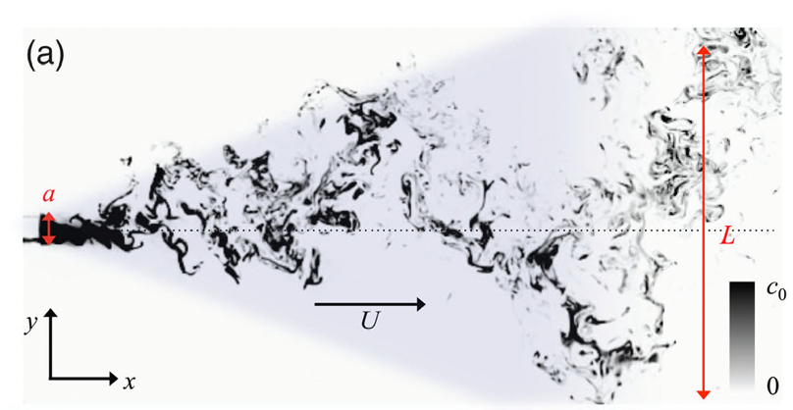
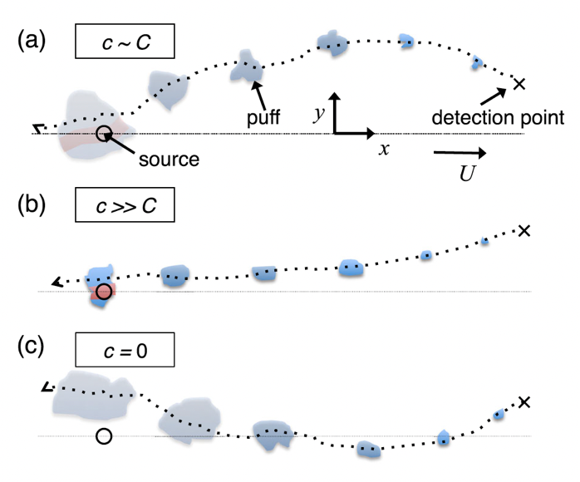
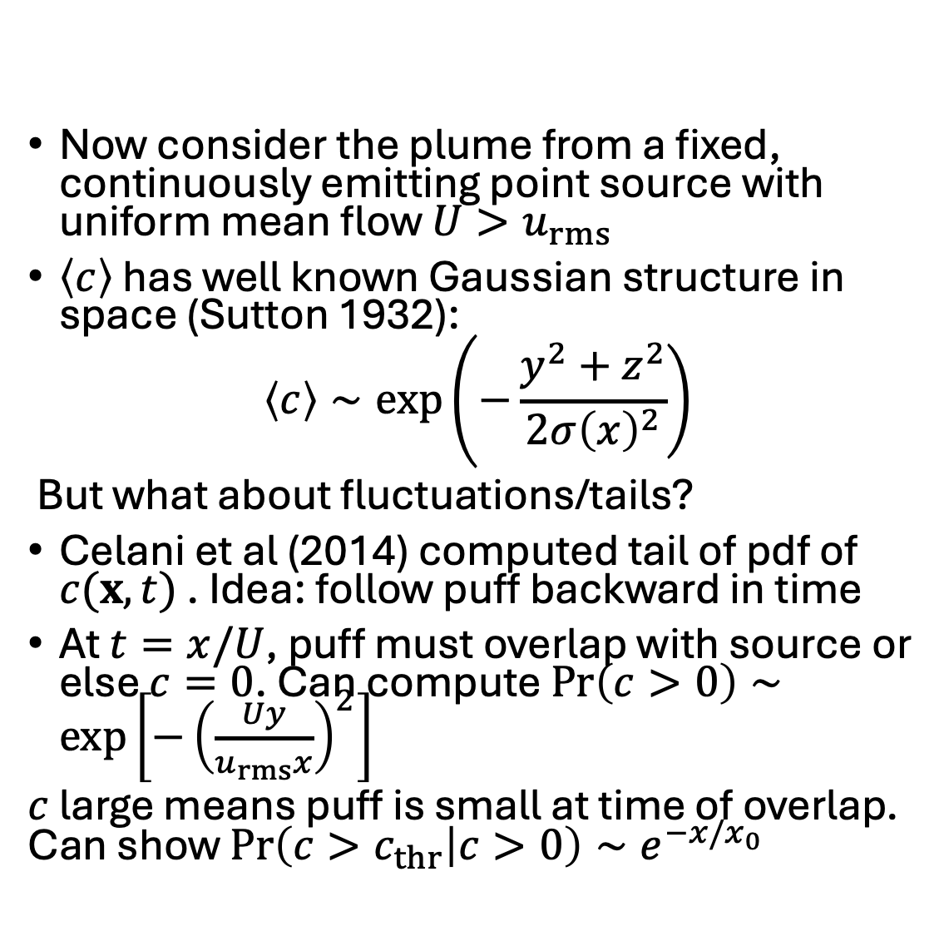
Odor plumes
Now consider the plume from a fixed, continuously emitting point source with uniform mean flow $U>u_{rms}$
$\left\langle c\right\rangle$ has well known Gaussian structure in space (Sutton 1932):
$$\left\langle c\right\rangle ∼exp\left.\left(−\frac{y^{2}+z^{2}}{2σ{\left(x\right)}^{2}}\right.\right)$$
But what about fluctuations/tails?
Celani et al (2014) computed tail of pdf of $c(x,t)$ . Idea: follow puff backward in time
At $t=x/U$, puff must overlap with source or else $c=0$. Can compute $\operatorname{Pr}\left(c>0\right)∼\exp\left[−{\left(\frac{Uy}{u_{rms}x}\right)}^{2}\right]$
$c$ large means puff is small at time of overlap. Can show $\operatorname{Pr}\left(c>c_{thr} | c>0\right)∼e^{−x/x_{0}}$
Notes:
What are we exploiting to use backward in time trick? (time inversion symmetry of Euler). Last lines: we are ignoring power law corrections. Pr(c>0) confines plume to cone and is signature of intermittency

Slide 13
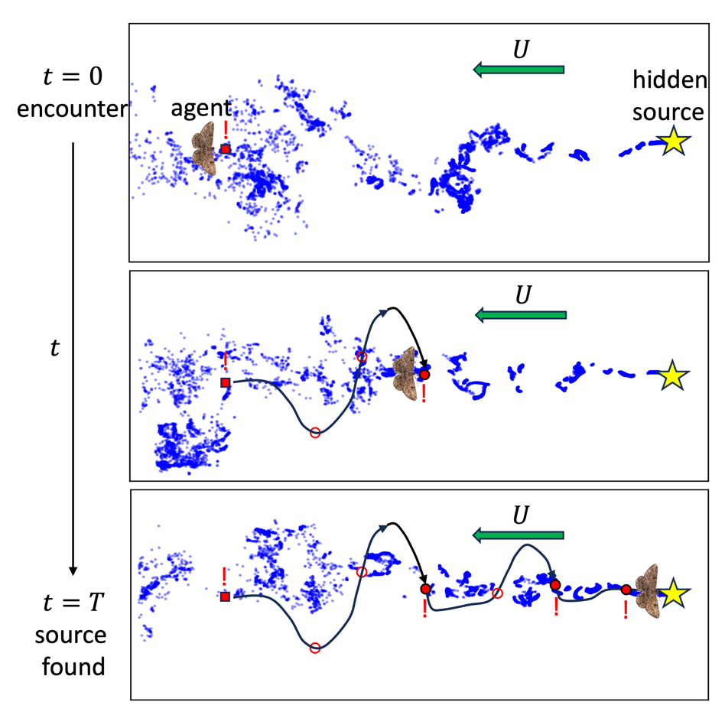
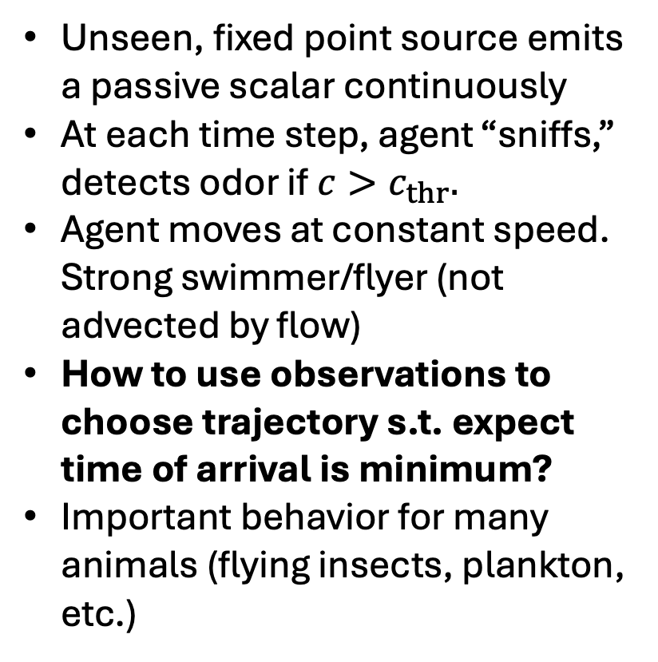
Olfactory search
Unseen, fixed point source emits a passive scalar continuously
At each time step, agent “sniffs,” detects odor if $c>c_{thr}.$
Agent moves at constant speed. Strong swimmer/flyer (not advected by flow)
How to use observations to choose trajectory s.t. expect time of arrival is minimum?
Important behavior for many animals (flying insects, plankton, etc.)

Slide 14
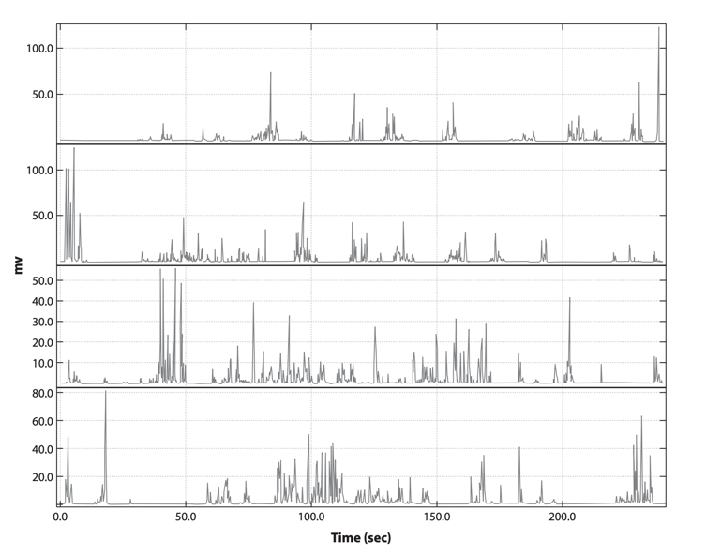

Olfactory search is hard
Observation signal is highly intermittent. We have already seen e.g. that $c=0$ with finite probability
As a result, local concentration gradients frequently do not exist instantaneously. If they do, they may point in “wrong” direction
Odor encounters are random, and rare when far from source
Thus the observation sequence supplies only limited, imperfect information about the source
Concentration time series at fixed point 50 m downwind of propylene source (Yee et al 1994)

Slide 15
Summary of Lecture 1
We have introduced two problems (microswimmers, olfactory search) in Lagrangian turbulence
We have discussed the physics of why these problems are difficult (e.g. intermittency and Lagrangian chaos)
Soon we will formalize both problems as “Markov decision processes” as a first step towards solving them.
But first: a brief introduction to optimal control theory, and why it is not the ideal choice for these problems
Questions?

